Slide 1

Efficient Top-K Retrieval with Signatures
Timothy Chappell
(t.chappell@connect.qut.edu.au)
Anthony Nguyen
(anthony.nguyen@csiro.au)
Shlomo Geva
(s.geva@qut.edu.au)
Guido Zuccon
(guido.zuccon@csiro.au)

Slide 2
Document Signatures
Created with locality-sensitive hashing
Bitwise (Hamming) distance of signatures approximates similarity of source documents
Successfully used for text, image and audio searching

Slide 3
Document Signatures
Hamming distance computations need to be performed against every signature in a search collection
Infeasible for large collections
Necessary if the entire collection must be ranked – however, if we are only after top-k it should not be necessary to compare against the entire collection

Slide 4
Inverted Signature Table
Each signature is divided into binary substrings of a fixed width
Every [substring, position] pair is associated with a list of the signatures it appears in
By searching for a small number of permutations of each substring of the query signature, most nearby signatures can be located

Slide 5









Constructing the Table
0
1
2
3
4
5
6
7
 | 0000 | 0001 | 0010 | 0011 | 0100 | 0101 | 0110 | 0111 | 1000 | 1001 | 1010 | 1011 | 1100 | 1101 | 1110 | 1111
0
1
2
3
4
5
6
7
Notes:
Document signature is split into substrings
The document is then listed in the lists belonging to each substring,pos pair

Slide 6
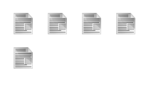

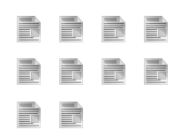
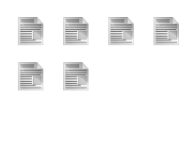
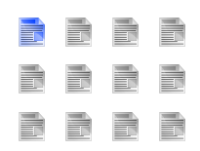

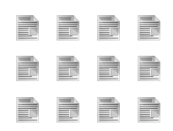
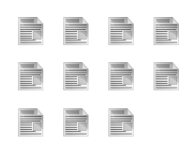
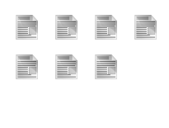

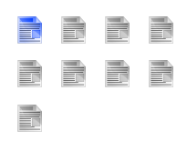




Constructing the Table
The final table:
 | 0000 | 0001 | 0010 | 0011 | 0100 | 0101 | 0110 | 0111 | 1000 | 1001 | 1010 | 1011 | 1100 | 1101 | 1110 | 1111
0
1
2
3
4
5
6
7
Notes:
-The rest of the collection is processed in this way, adding to the number of documents that appear in the table
Some lists will usually remain empty even after the entire collection has been indexed
We use a 2-pass process for creating this table; one to determine how large each of the lists must be and one to fill the lists

Slide 7


Searching the table
4
 | 0000 | 0001 | 0010 | 0011 | 0100 | 0101 | 0110 | 0111 | 1000 | 1001
0
1
2
3
4
5
6
7
3
2
1
0
Notes:
Searching is a similar process to indexing, but requires the search query to be expanded to capture similar but not identical signatures.
For each substring, permutations of that substring with an increasing number of bit errors are also considered
Each substring permutation is allocated a score based on how many bits it has in common with the original substring
Each permutation is used to search the table and the documents retrieved are awarded the score value of the permutation they were located with
After every permutation has been considered, the score of the documents will exactly equal their Hamming distance
For efficiency reasons, rather than considering all permutations, we stop after a certain number of permutations have been considered and use the ranking so far to determine the top-K

Slide 8
Searching the table
After processing all substring lists, the highest scoring signatures are extracted from the table and compared against the query signature to get the true Hamming distance
As a result, the Hamming distance calculation only needs to be performed on a fraction of the signatures in the collection

Slide 9
Hamming Distance Ratio
Acts as a substitute for Average Precision when relevance is not known but similarity is
A_{j} as the Hamming distance of the j^{th}-ranked signature in the collection
B_{j} as the Hamming distance of the j^{th}-ranked result of the output being tested

Slide 10

Hamming Distance Ratio
0 | 3 | 3 | 5 | 11 | 16 | 20 | 22 | 24 | 29
0 | 3 | 3 | 5 | 11 | 16 | 20 | 22 | 24 | 29
A = Hamming distances of the k signatures closest to the query (ground truth)
B = Hamming distances of the k signatures returned by the evaluated algorithm
A | B
0 | 0
3 | 3
3 | 5
5 | 11
11 | 20
i
i
i
i
i
i
∑ A | ∑ B
0 | 0
3 | 3
6 | 8
11 | 19
22 | 39
∑ A ÷ ∑ B
0 ÷ 0 = 1.00
3 ÷ 3 = 1.00
6 ÷ 8 = 0.75
11 ÷ 19 ~= 0.58
22 ÷ 39 ~= 0.56
1
1
1
1
i
i
∑ A ÷ ∑ B
~0.77
1
1

Slide 11
HDR as a function of neighbourhood expansion
1024-bit signatures, 16-bit substrings
0 | 0.86
1 | 0.92
2 | 0.96
3 | 0.98
4 | 0.99
5 | 1.00
6 | 1.00
7 | 1.00
8 | 1.00
9 | 1.00
10 | 1.00
11 | 1.00
12 | 1.00
13 | 1.00
14 | 1.00
15 | 1.00
16 | 1.00

Slide 12
Query time as affected by neighbourhood expansion
1024-bit signatures, 16-bit substrings, 1,048,576 documents

Slide 13
Substring width tuning
Allows trade-off between memory usage and query time
Increasing the substring width increases the size of the inverted table, reducing the number of signatures in each list
The extra memory usage is pure overhead (does not increase with collection size)

Slide 14
Query time and memory use as a function of substring width
1024-bit signatures, 1,048,576 documents

Slide 15
Current work
Parallel searching
  This approach is trivially parallelisable
Signature table is immutable during searching
Reduce individual query execution time
  Fraction of substrings allocated to each thread
  Synchronise once for each query
Reduce overall time for batch processing
  Queries allocated to different threads
  No need to synchronise (until the very end)

Slide 16
Summary
Inverted signature tables allow a great increase in query performance over exhaustive Hamming neighbourhood searches at the cost of memory usage and precision
Substring width can be increased for greater speed at the cost of additional memory use

Slide 17
Any questions?

